Slide 1


Relaxation Strategies
By Mrs. Thompson
School Counselor

Slide 2
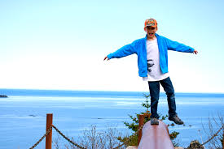
WE ALL NEED TO BE BALANCED
Families may be working hard from home or out of the house while taking care of you.
Getting used to distance learning.
Spending lots of time with your family, siblings and getting along.
You may be asked to do more chores at home or have more responsibility.

Slide 3
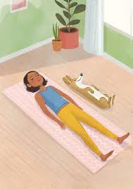
BREATHING

Slide 4
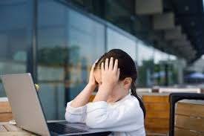
Think about your breathing when you are:
Sleeping
Exercising
Excited
Angry
Scared
Nervous

Slide 5
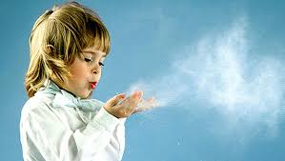
THE EFFECTS OF BREATHING
Fills your body with air
Brain receives oxygen
Feelings of being calm, relaxed, less nervous or afraid, in control

Slide 6
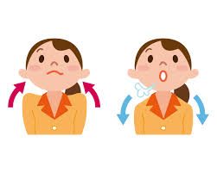
TAKE CONTROL
4-5-6
-Breathe in for 4
-Hold for 5
-Breathe out for 6

Slide 7

BREATHING STORY

Slide 8
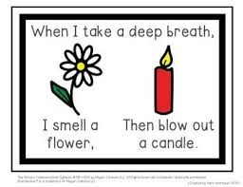
FLOWER & CANDLE

Slide 9

Belly Breathing

Slide 10
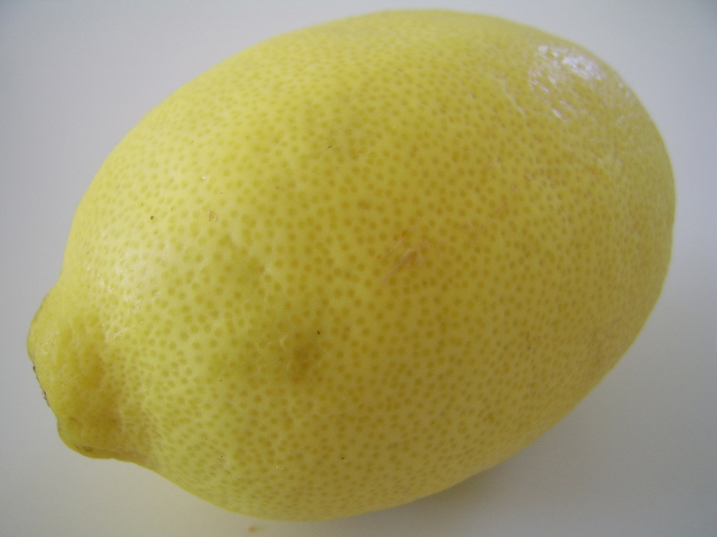
SQUEEZE A LEMON

Slide 11
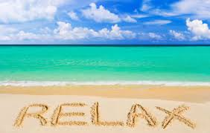
Let’s Review Ways to Stay Calm
Otter breathing in for 4 and out for 4 through your nose
4-5-6 breathing
Flower & Candle
Belly Breathing
Squeeze a Lemon

